Slide 1
Unit 2
World Geography Review

Slide 2
Relationships
Weather vs climate
Weather = the state of the atmosphere at any one place or time. (short term)
Climate = the average weather conditions of a region over the LONG term. (Season, Month Annually

Slide 3
2.1.4
Revolution, and earth's tilt on its axis (hint: seasons)
March 21st
North = Spring
12 hrs day & 12 hrs night
Noon Sun 90⁰ @ Equator
South = Fall
Dec 21st
North = Winter
Less sun hours
Less direct sun
South = Summer
More sun hours
More direct sun
Noon Sun 90⁰ @ Tropic of Capricorn
June 21st
North = Summer
More sun hours
More direct sun
Noon Sun 90⁰ @ Tropic of Cancer
South = Winter
Less sun hours
Less direct sun
September 21st
North = Fall
12 hrs day & 12 hrs night
Noon Sun 90⁰ @ Equator
South = Spring

Slide 4
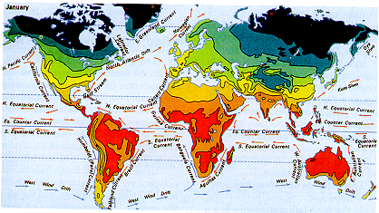
2.3.1 Generalize that temperatures tend to decrease as latitude increases
Temperature and latitude
Graphic Representation shows decreased temperature with increased latitude. # 13 P. 58
Thermal Photography shows the same. #14 p. 59

Slide 5
Convection cell

Slide 6
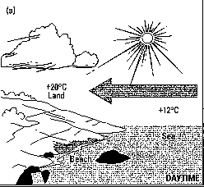
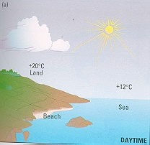
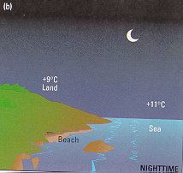
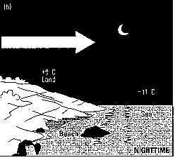
Land and sea breezes
Using your knowledge of wind predict & explain the wind directions below. P. 61
Sea Breeze
Land Breeze
Sea air warmer than land air
Air rises over sea
Relative Low pressure over sea
Land air moves to lower pressure
Land air warmer than sea air
Air rises over land
Relative Low pressure over land
Sea air moves to lower pressure

Slide 7
Pressure belts of the world

Slide 8
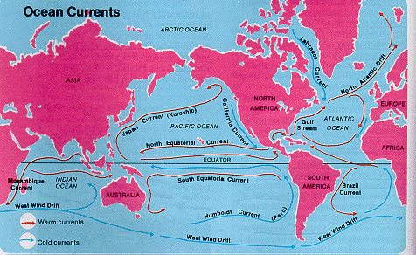
Explain how ocean currents affect climate on nearby land.
Affect of cold ocean currents
Cools the summer temperature
2. Reduces precipitation; cooler air holds less moisture
Affect of warm ocean currents
Warms the winter temperature
2. Increases precipitation; warmer air holds more moisture

Slide 9
DID YOU KNOW?
Air temperature decreases 2ºC for every 300m increase in elevation
IT’S TRUE!! In fact, the higher up we go; the colder it gets; hence snow on mountain tops

Slide 10
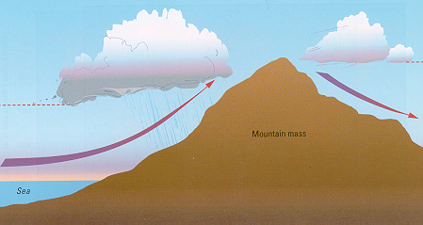
Relief Rainfall – Recap!!! Elevation and Precipitation
Windward = side of a mountain wind blows toward
Leeward = side of mountain opposite from windward
Rain shadow = region on leeward side of mountain that receives little precipitation because most rain dropped on windward side.

Slide 11
2.6.3 Analyze the relationship between temperature and precipitation of a point and its location relative to a mountain system.
Cities higher up in a mountain have colder temperatures
Cities on leeward side have little rain (rain shadow)
Cities on windward side have more rain
Match the city to the data
1113mm rain & 0ºC coldest month
628mm rain & -12ºC coldest month
Vancouver
Prince George
wind

Slide 12
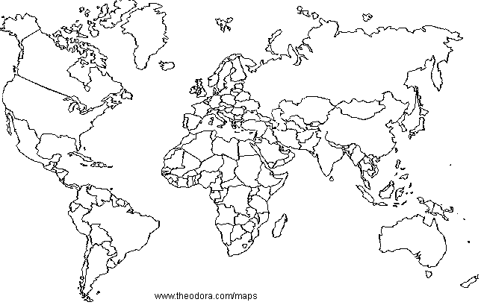
Know why winter and summer monsoons occur. P. 70-71
India’s Winter monsoon
India’s Summer monsoon
H
L
L
H
Continental Asia heats up
Low atm. pressure results
Wind blows northward towards the low over India
Tremendous rains; wind blowing over warm Indian ocean
Continental Asia cools
High atm. pressure results
Wind blows southward towards the low over Indian ocean
Very little rain; wind blowing over dry land

Slide 13
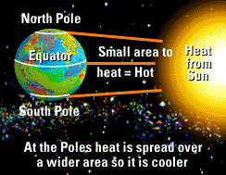
2.1.6 Describe the factors that account for differences in temperature as seasons change.
Summer = Longer day = more heat
2. Sun rays more direct = more intensity/unit area= more heat

Slide 14
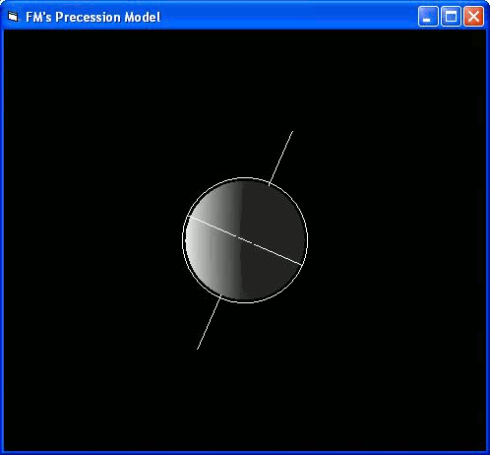
Tilt of the Earth
The earth is tilted on its axis @ 23.5º
At different times of the year, the North (or South) is pointed towards the sun, while other times pointed away from the sun.
Causes daylight to be longer or shorter.
Contributes to the seasons as well.

Slide 15
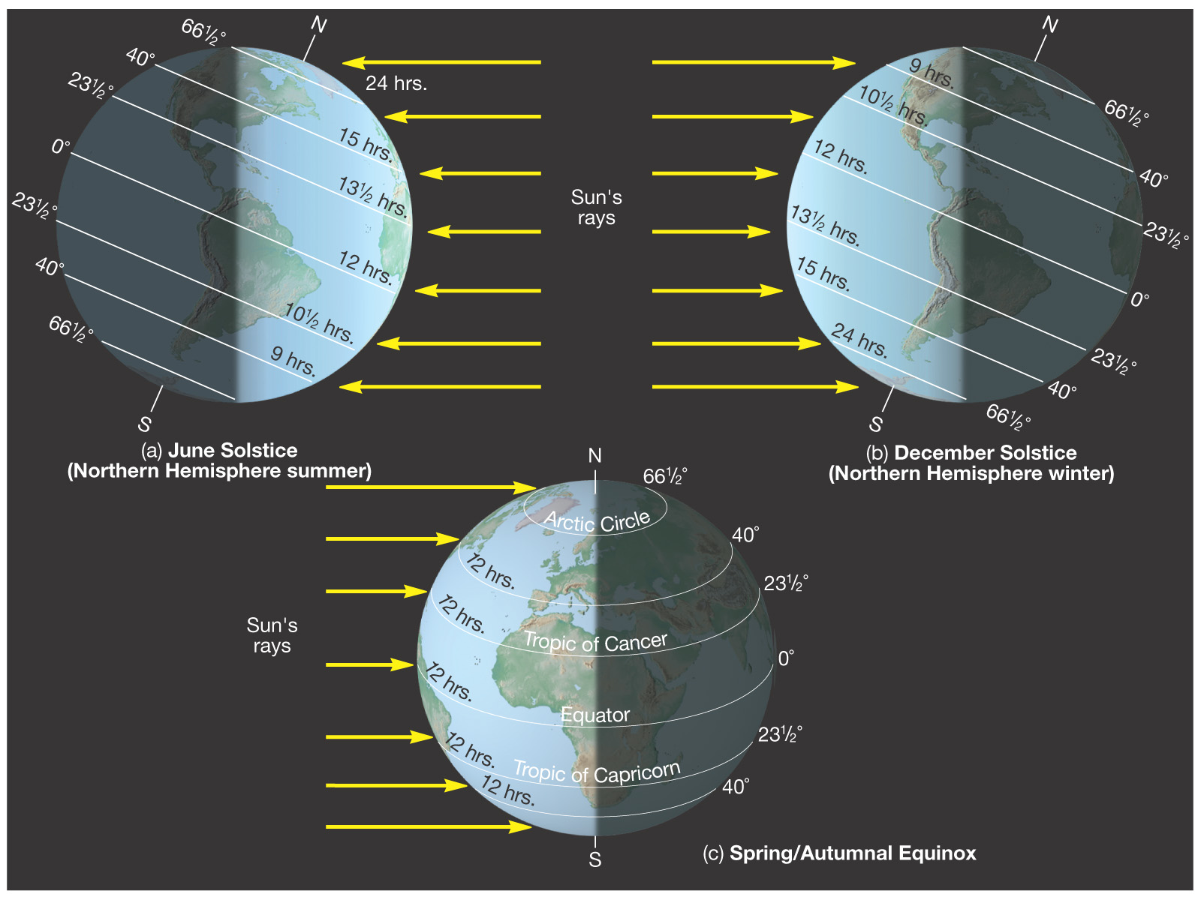

Slide 16
Day vs Night & Length of day (daylight!)
Rotation on the axis causes day and night
Tilt on axis causes length of day to be longer or shorter.
When hemisphere is pointed towards the sun…
that hemisphere receives more direct, intense heat radiation AND
More hours of exposure to the sun
Giving that hemisphere longer days AND
Warmer temperatures (Summer!!)

Slide 17
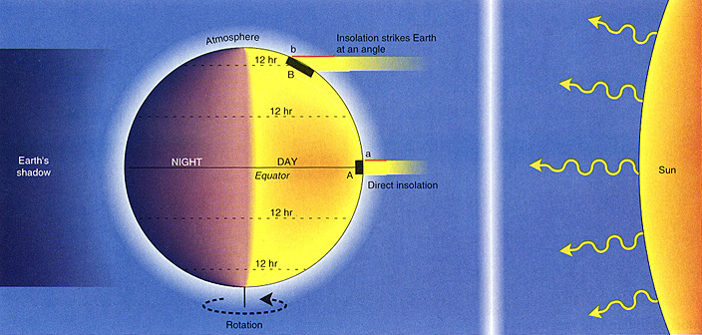
Equal Day and Night…BUT…
Differences in Temperatures!? Why?

Slide 18
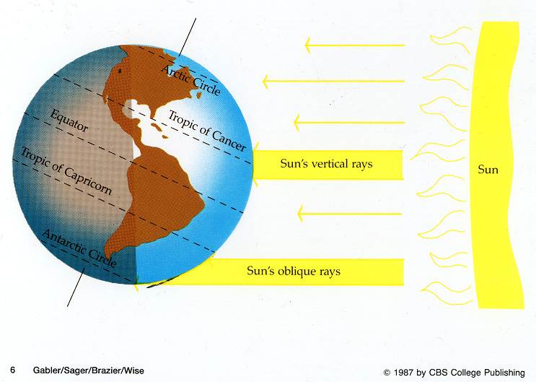
Intensity and Duration!!

Slide 19
Explain why only about ½ of the sunlight directed at earth actually reaches the earth.

Slide 20
49% of sun’s radiation actually reaches the earth’s surface
6% is scattered in the atmosphere
24 % is reflected by clouds
4 % is reflected by the earth’s surface.
17 % is absorbed by Green House gases & dust

Slide 21
While the 4 % that reflects from the earth’s surface is small it does vary with location & with time.
How/Why do you think it varies?
Winter vs. Summer?
Poles Vs. equator?
Land vs. ocean?
HINT: Precipitation (Snow & water), reflection vs absorption, dust, cloud cover, angle of sun,

Slide 22
Tropical Climates - Common
LOW latitudes (near equator)
Between the “Tropics!”
Temp. over 18⁰C every day
Hence a relatively flat temperature line
warm ocean currents & prevailing winds = high precipitation.

Slide 23
REALLY ?!?!
NOTE: Even though the tropic climates are hot, they are not the hottest climatic region. Why not?
With rainfall comes constant cloud cover…which reduces the amount of sunlight reaching the earth.
What other effect can cloud cover have on temperatures in this region?
HINT: NIGHT….
Muggy!!! Hot, wet air

Slide 24
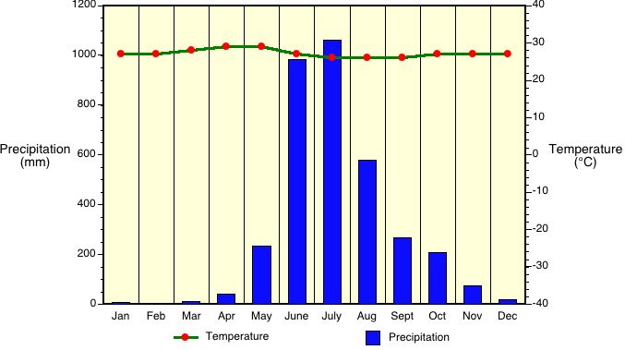
Tropical Wet & Dry - Climate graphs
Notice:
Relatively flat temperature line
Temperature relatively constant & high (19-27⁰C)
Wet and dry seasons (monsoons)!!!

Slide 25
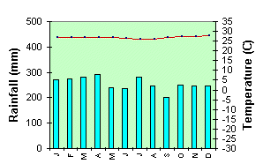
Tropical Wet - Climate graphs
Precipitation in each month is high
Temperature constant & high (19-27⁰C)
Relatively flat temperature line

Slide 26
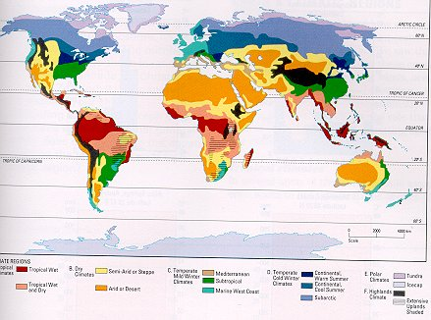
Dry Climates

Slide 27
Dry Climates
All Dry climates:
< 500mm precipitation annually
10-30 N & S
May be continental, leeward side of mountain or influenced by cold ocean current.
More evaporation than precipitation
Little vegetation
Often windy with No cloud cover
High daytime temperatures, Low nighttime temperatures
Temperatures may vary seasonally

Slide 28
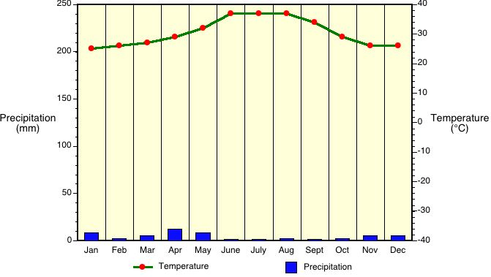
Arid - Climate graphs

Slide 29
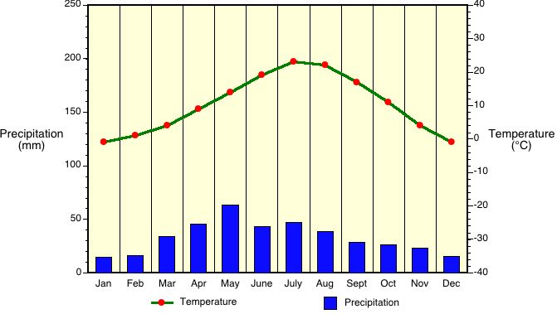
Semi-Arid - Climate graphs

Slide 30
REMEMBER!!!!
The main factor that characterizes the DRY climate zone is the amount of precipitation – that is, there is not much!

Slide 31
Temperate Mild Winter
Temperate Mild Winter
Mild winter ( above -3ºC).
Mild winters usually caused by ocean currents
Mid Latitudes (30-60 N & S)
Usually near oceans (coastal)
Summer temperatures vary

Slide 32
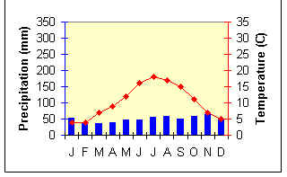
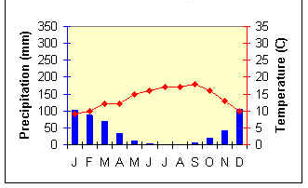
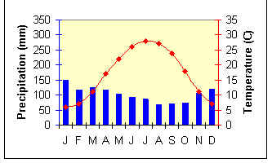
Temperate Mild Winter
Marine West Coast
Which is further north??
Mediterranean
Subtropical

Slide 33
Temperate COLD Winter
Locations generally affected by continentality Ex. Reason for colder winters!
Mostly inland (continental)
Generally the mid Latitudes (30-60 N)
Highest precipitation occurs during summer

Slide 34
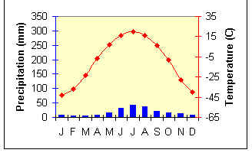
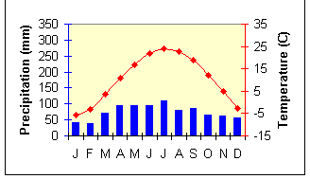
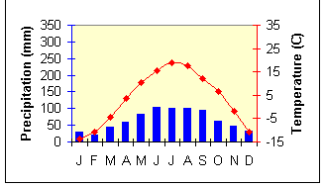
Temperate COLD Winter
Subarctic
Which is further north??
Continental Warm Summer
Continental Cool Summer

Slide 35
Polar Region
Polar Region
High latitudes
(+60º latitude)
Near poles
Short cool summers
Never exceeds 10º C
Coldest, darkest & driest winters

Slide 36
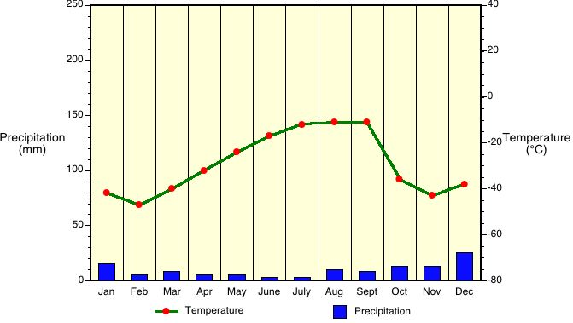
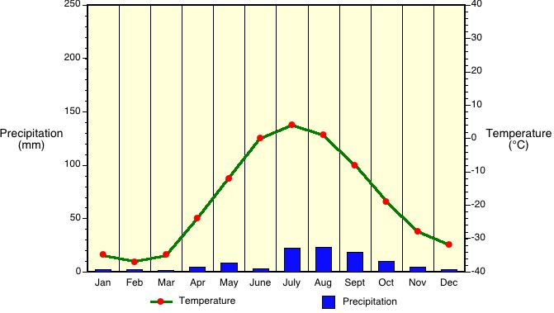
Ice Cap
Which is further north??
Tundra
Notice how little precipitation occurs. WHY???

Slide 37
Highlands
Elevations over 1000 m
Colder conditions than the lower lying areas surrounding it.
Climates from one highland to another will vary because of latitude, proximity to oceans

