Slide 1
World Geography 3202
Unit 2
Climate Patterns

Slide 2
Introduction
In this unit, we will examine some of the basic forces that produce our weather and climate, how they produce climate patterns on the earth’s surface, and relate to human activity.
These patterns are strongly affected by the distribution of landforms and water forms.

Slide 3
Weather Vs. Climate
Weather is a measurement of daily atmospheric conditions
Climate is a measure of weather over an extended period of time, usually considered to be a season.

Slide 4
Weather and Climate: The earth, itself
The earth’s movement in space causes the occurrence of day and night.
It also causes the conditions related to the seasons.
When we refer to the rotation of the earth, we are referring to the 24 hour period it takes the earth to complete one full “spin” in orbit around the sun.
  It is this 24 hour “spin” that causes the periods of day and night, as the sun shines only on the half of the earth that is pointed toward the sun.

Slide 5
Weather and Climate: The earth, itself
When we refer to the earth’s revolution, we are referring to the approximately 365 days that it takes the earth to revolve on it’s orbit around the sun.
  This revolution is responsible for the seasons, as the portions of the earth that are more directly or less directly exposed to the sun’s rays will correspondingly experience different seasons.

Slide 6
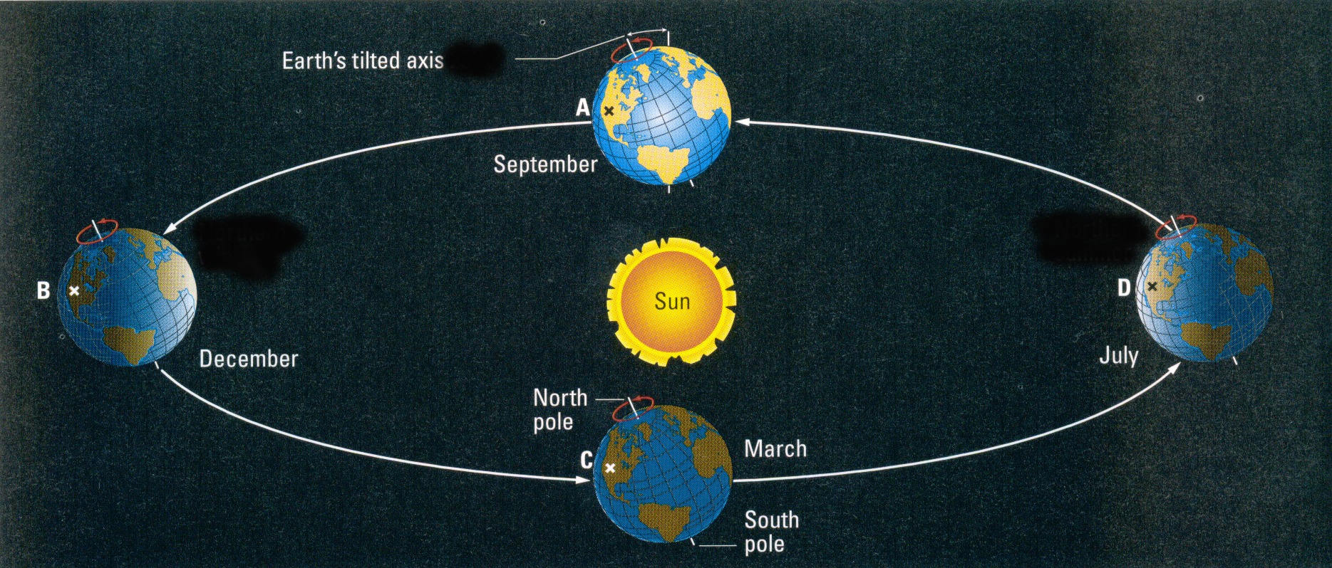
Weather and Climate: The earth, itself
Equinox: Refers to the period in the year when day and night are equal (12 hours long). This occurs twice a year, in March and September.
Solstice: Refers to the period in the year when daylight is longest (or daylight is shortest) depending on the hemisphere: This occurs twice a year, in June and December

Slide 7
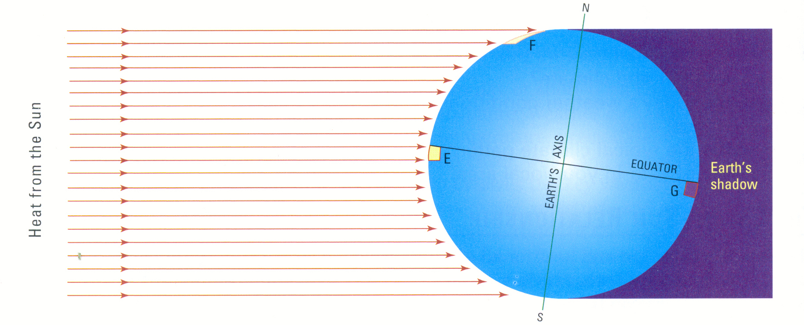
Solar Intensity
The diagram above attempts to illustrate how the sun’s rays are dispersed as they strike the earth. The more direct the rays are, the more intense, and hence, more heat they give off.
Where are temperatures generally going to be the warmest on the earth? Why?

Slide 8
Solar Intensity
temperatures tend to decrease from low to high latitudes.
Where might there be an exception to this rule at the equator (ie: There Are places at the equator that are extremely cold).

Slide 9
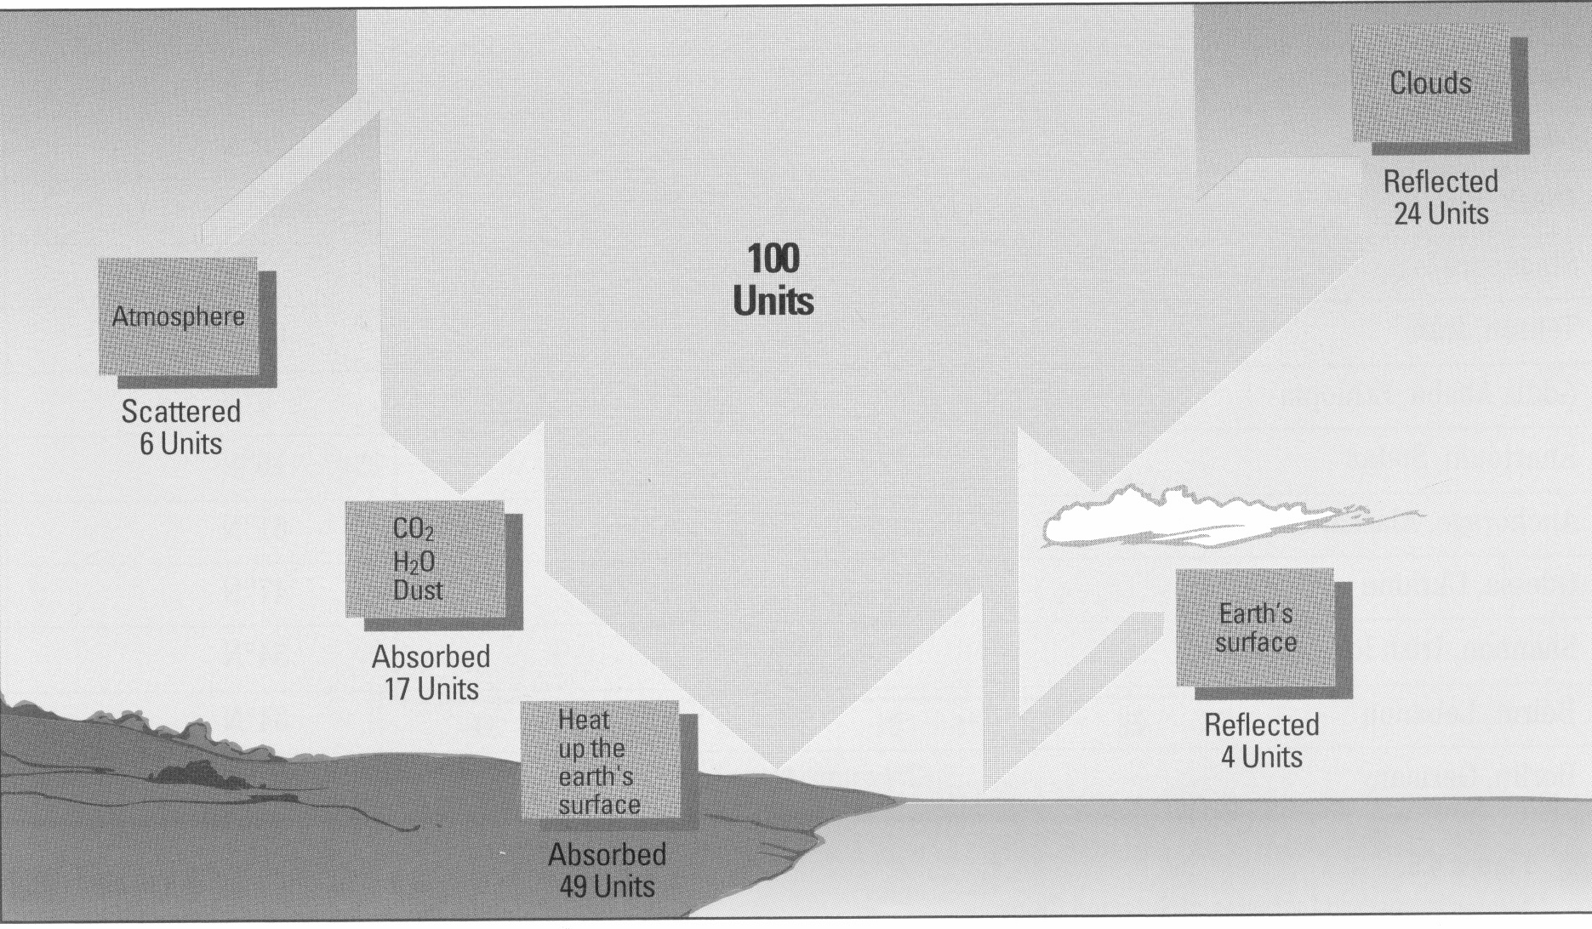
Solar inputs and outputs
How cloud cover influences the range of temperatures from day to night.
How the greenhouse effect moderates climates.

