Slide 1
World Geography 3202
Unit 2
Climate Patterns

Slide 2
Wind and precipitation
When warm air cools, it cannot hold as much water vapour.
Temperatures rise as air pressure increases, temperature lowers as air pressure decreases.

Slide 3
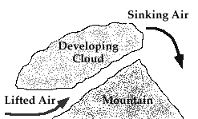
Orographic precipiation
When warm moist air from the sea reaches cool coastal mountain air, the result is frequent precipitation on the windward side of the mountain. The leeward side of the mountain receives very little precipitation and is said to be in a rain shadow.

Slide 4
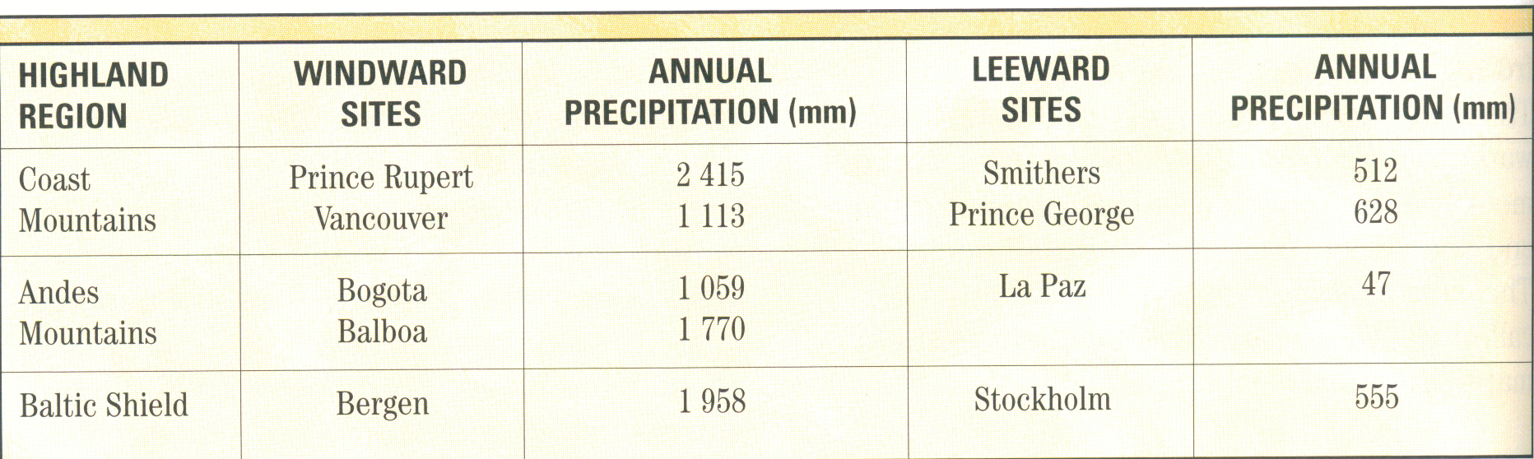
Windward and Leeward Precipitation

Slide 5
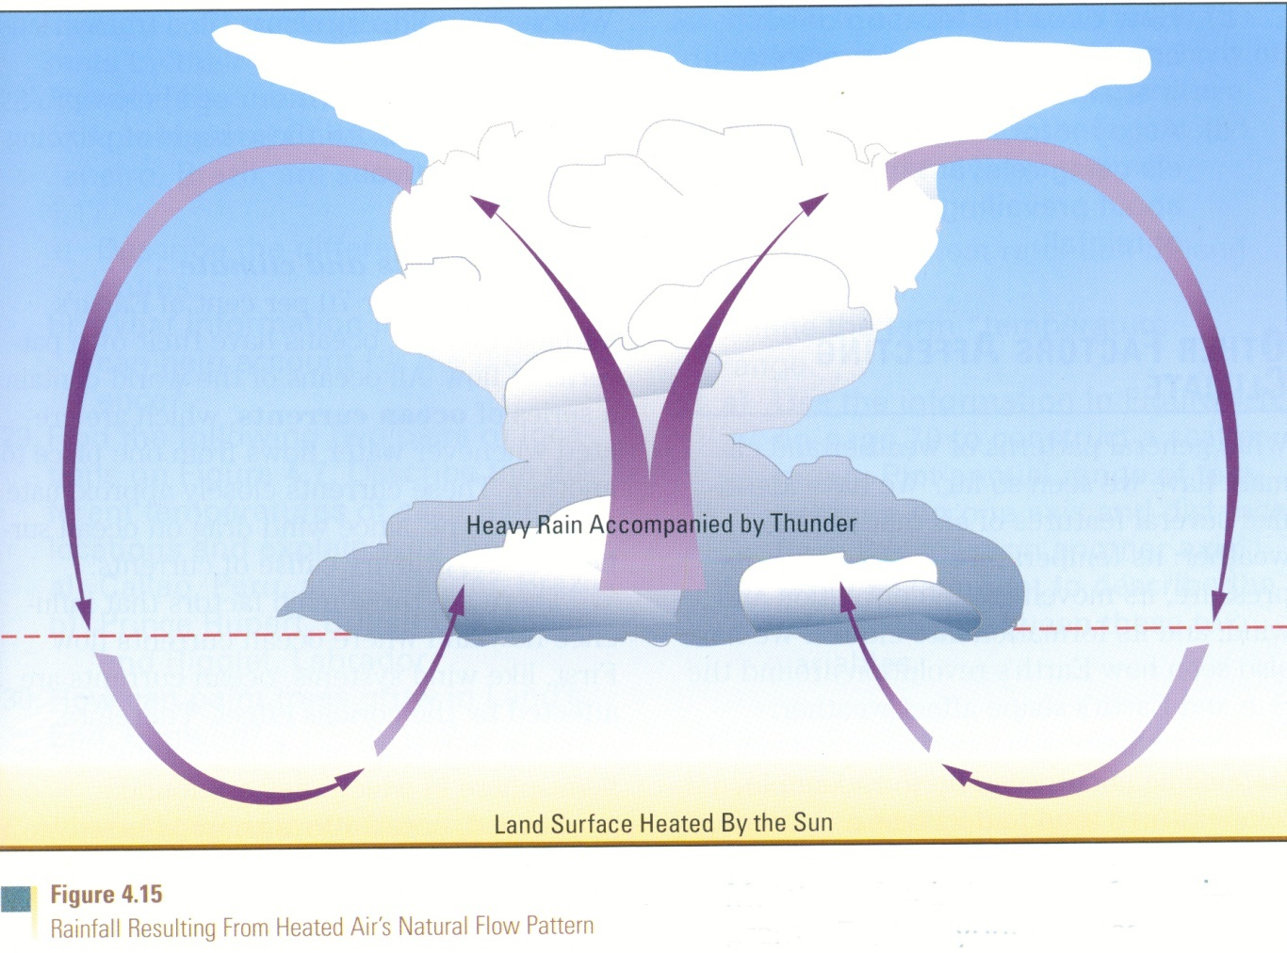
Convectional Precipitation
Occurs when very warm air comes into contact with a cold front, and results in violent precipitation with thunder, lightning and even tornadoes.

Slide 6
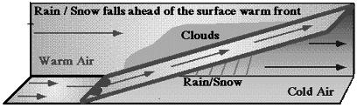
Frontal/Cyclonic
The most common form of precipitation is the result of a warm front and a cold front coming together.

Slide 7
How ocean currents affect climate
Ocean currents can be thought of as similar to air masses: Large bodies of water traveling in a particular direction.
Indeed, ocean currents closely aproximate wind currents.
There are cold ocean currents and warm ocean currents.
  The bodies of land that are close to ocean currents are directly affected by the type of ocean current that passes by.

Slide 8
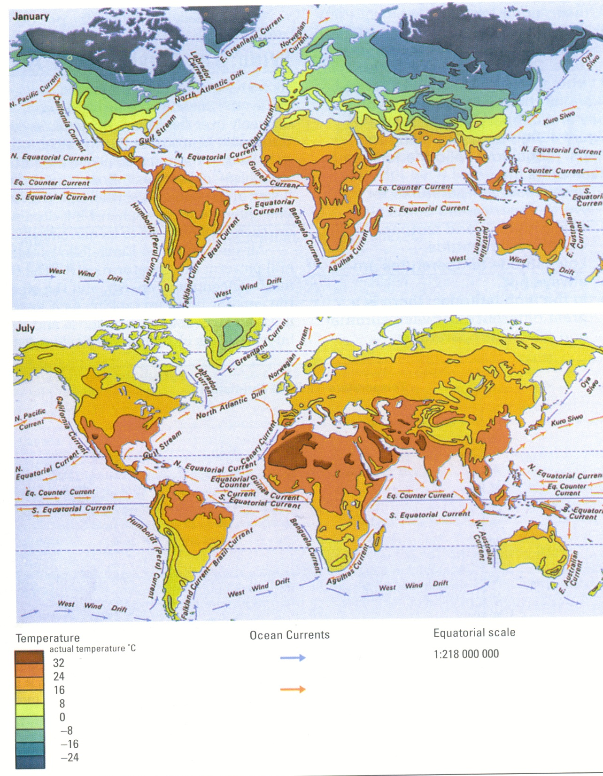
Ocean Current and land temperatures
ocean currents can create different climatic conditions for two locations on the same
latitude.
Compare the climate of Newfoundland and England: England actually can grow palm trees, but Newfoundland cannot. Can ocean currents help explain this?

Slide 9
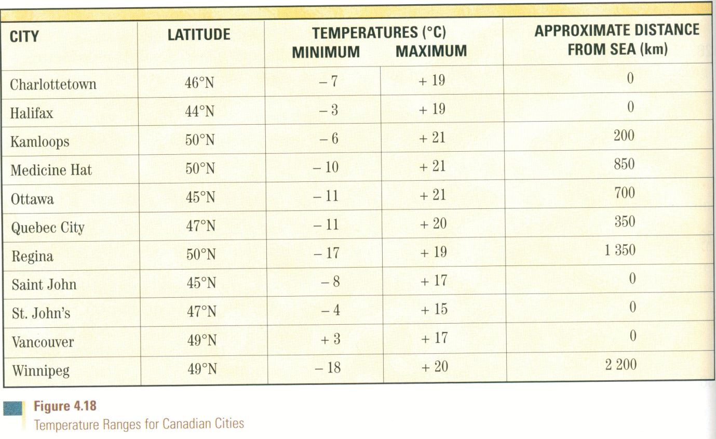
The relationship between range in temperature and distance from the ocean.
What does the graph suggest about the relationship between temperatures and distance from the ocean? Why is this the case?

Slide 10
Monsoons
Because the equatorial region receives a continual amount of direct sunlight, the region really does not have seasons that are reflected in terms of temperature.
However, there are parts of the equatorial region that experience seasons in the form of a variation in the amount of rainfall, in a lot of cases, a huge difference in the amount of rainfall…..

Slide 11
Monsoons
A monsoon refers to a sudden change in the tropics from a dry season to a wet season.
  Summers are hot and dry in these slightly higher latitudes (than tropical wet latitudes).
  In the winter, prevailing winds change direction, usually from blowing off the land, to blowing off the ocean (the Indian Ocean).
  The collision of air masses from the ocean and the land result in almost continual rainfall during the winter period.

Slide 12
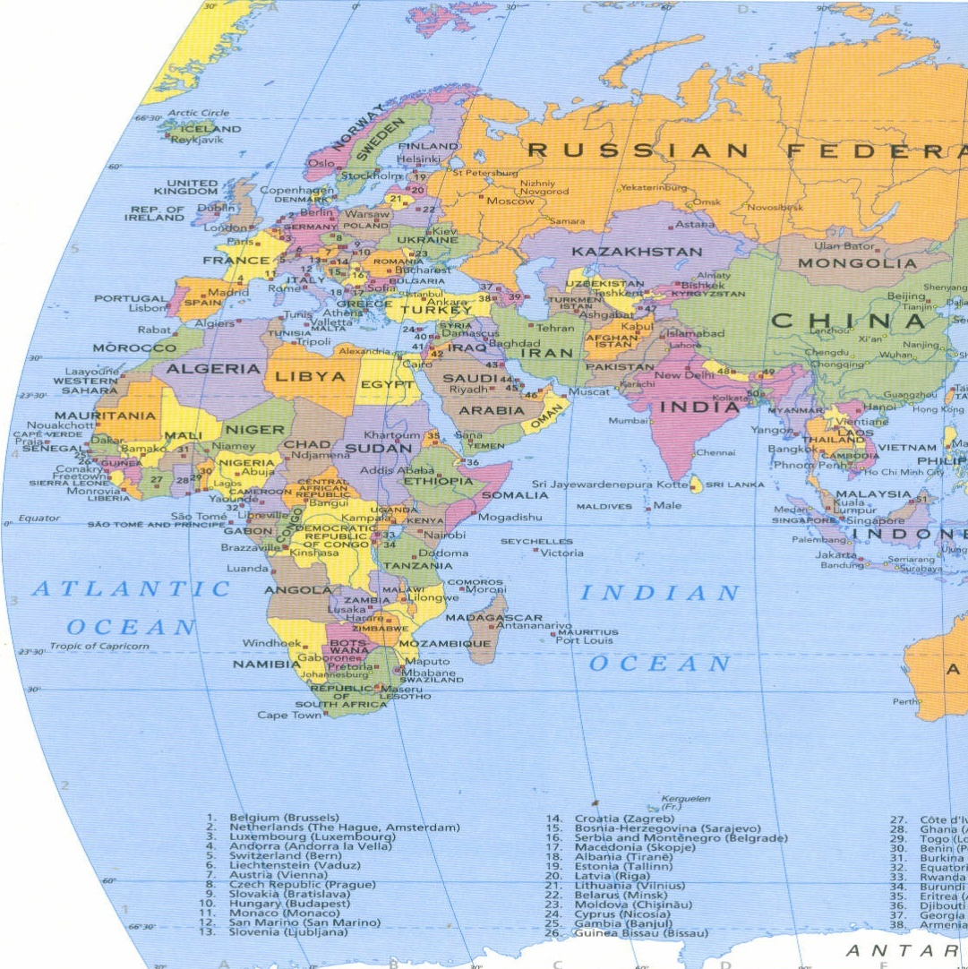
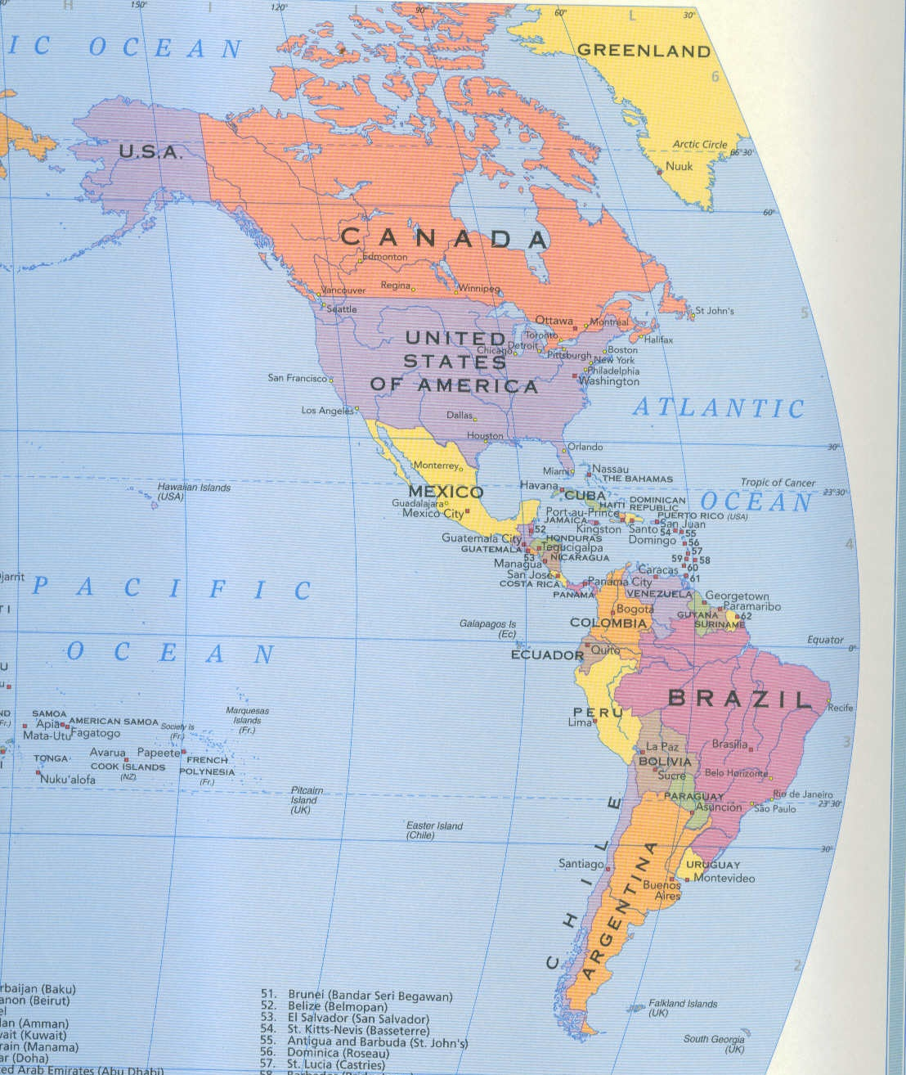
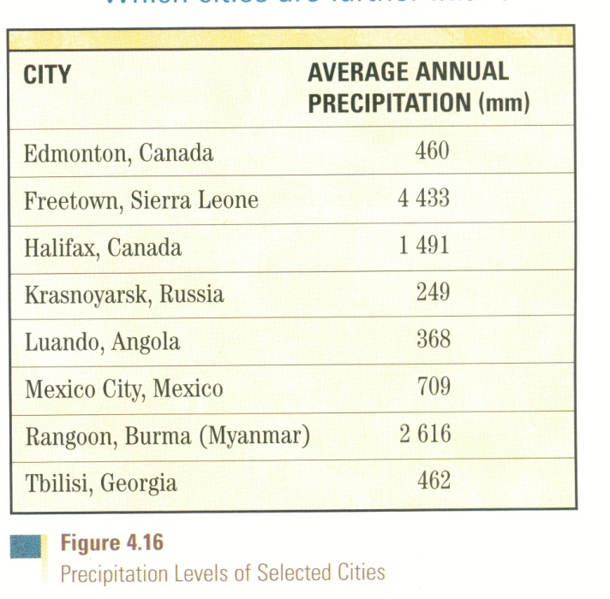
How does nearness to ocean affect precipitation?

